Slide 1


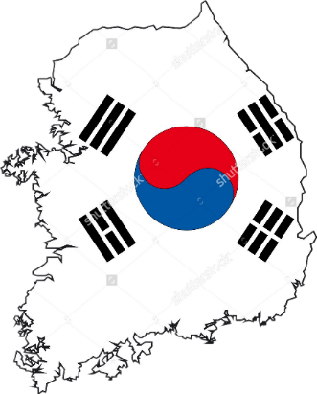

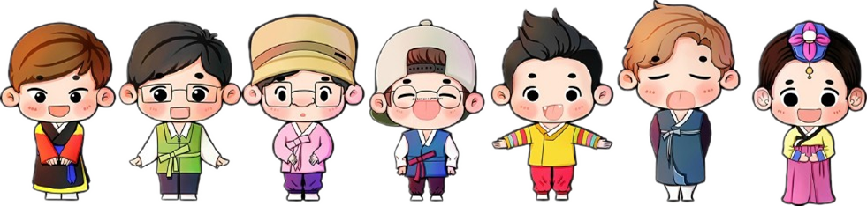
Shalini
Hu Yaning
Wang Yuqing
Meriam
Zhang Wentian
Abhishek

Slide 2







POLITICAL
Turbulent past
Independence in 1948
Military dictatorship from 1960’s to 1980’s
1986 democratic process was streamlined
President became the head of state

Slide 3

POLITICAL
Current Strengths
Centralisation of power
Strong relations with other countries
Democratic overturn in 1986
Single person authority system
Relation with US
Head of state, government and armed forces
Part of UN since 1991

Slide 4







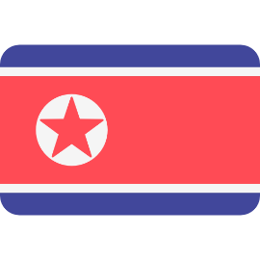
POLITICAL
Political violence
CHALLENGES
Influence of military on Politics
Uneasy relationship with North Korea

Slide 5






ECONOMY
Service
Storage & Communication
Financial Intermediary
Real Estate
Transport

Slide 6
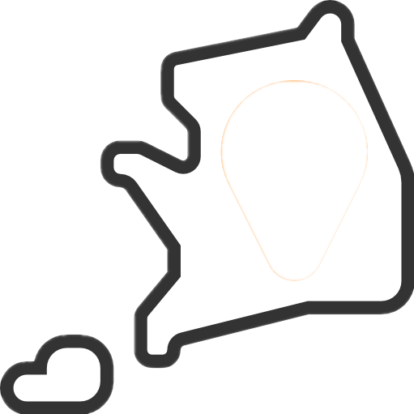




ECONOMY
Import
Export
relatively low
heavily for its GDP

Slide 7


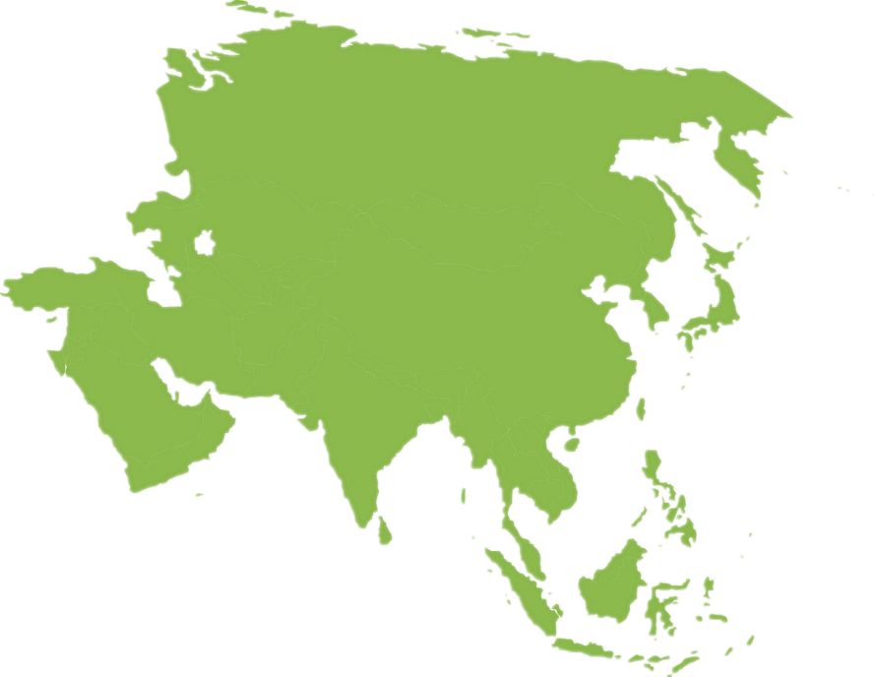


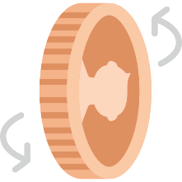




ECONOMY
recovery- GDP 6.7%↓ 9.3%↑
Financial Crisis
economic restructuring
liberalization
macroeconomic stability
reduce reliance on exports

Slide 8



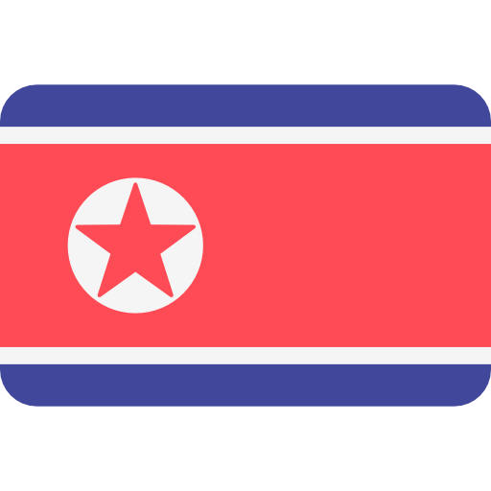
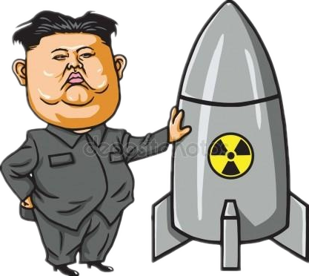

ECONOMY
Falling stock market
CHALLENGE
Hollowed-out foreign investment

Slide 9

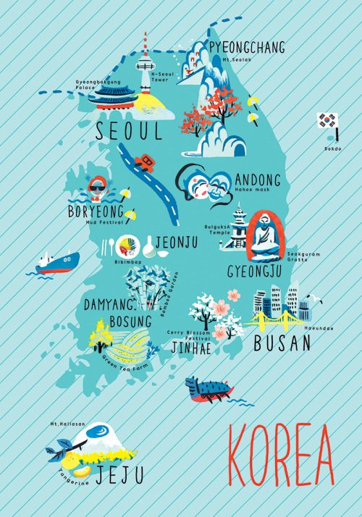






SOCIAL
51.4 million, 82.4% urban population
Seoul & Busan
Korean
Buddhism, Christianity
77 years (men), 84 years (women)

Slide 10

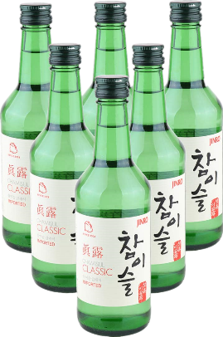

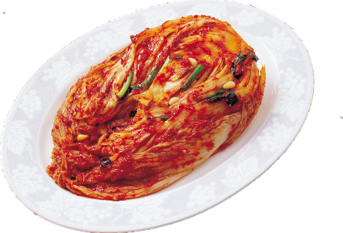
SOCIAL
Food & Holidays
Chuseok
Drinking culture
New Year’s Day
Staple food
Kimchi

Slide 11

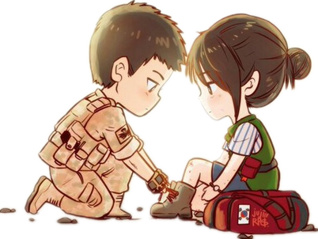
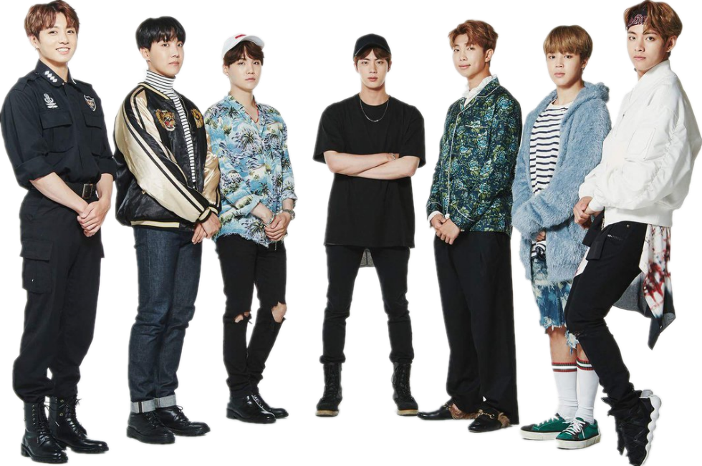
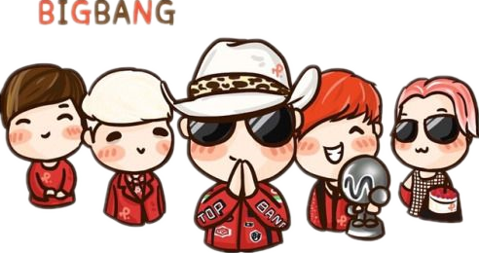

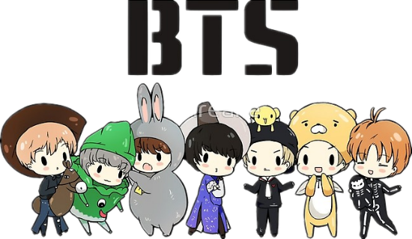
SOCIAL

Slide 12




SOCIAL
High income nation
Current Strengths
대한민국
High literacy rate
rapid urbanization
Continuous innovation

Slide 13

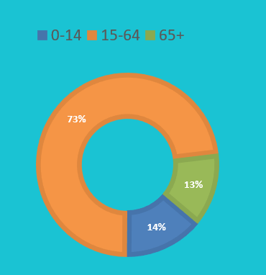


SOCIAL
Low fertility rate
Ageing population
CHALLENGE
Rise of labor unions
Low welfare spending

Slide 14
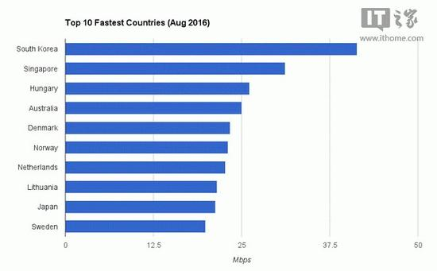

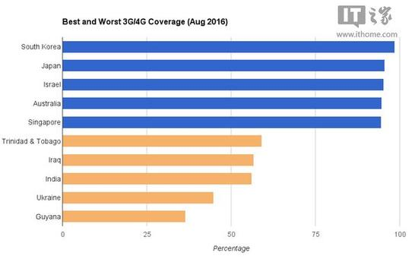
TECHNOLOGY
Current Strengths
Powerful Internet
The speed can reach 24.6Mbps, and the coverage is about 100.6%. Both rank the 1st all over the world.

Slide 15




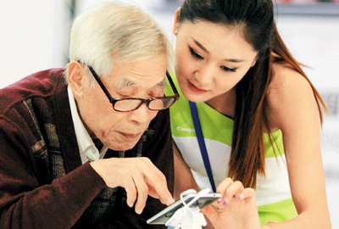
TECHNOLOGY
Current Strengths
Robust
Telecom
The highest rate of smartphone ownership, up to 88%, and South Korea is now one of the largest producers of mobile phones.

Slide 16
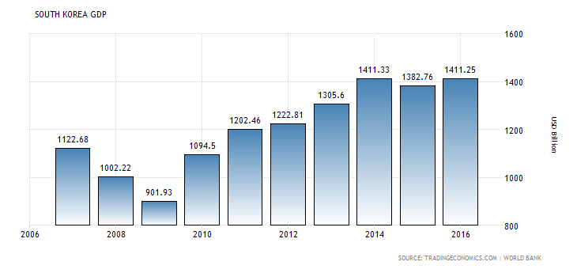

TECHNOLOGY
Current Strengths
Government support
In 2014, the investment in the field of R&D accounted for 4.29% of GDP, and the government plan to increase it to 5% by 2017.

Slide 17



TECHNOLOGY
Plutocrat hinders new growth industry
Plutocrat hinders new growth industry
CHALLENGES
Competitive neighbor
Over-regulated governance

Slide 18
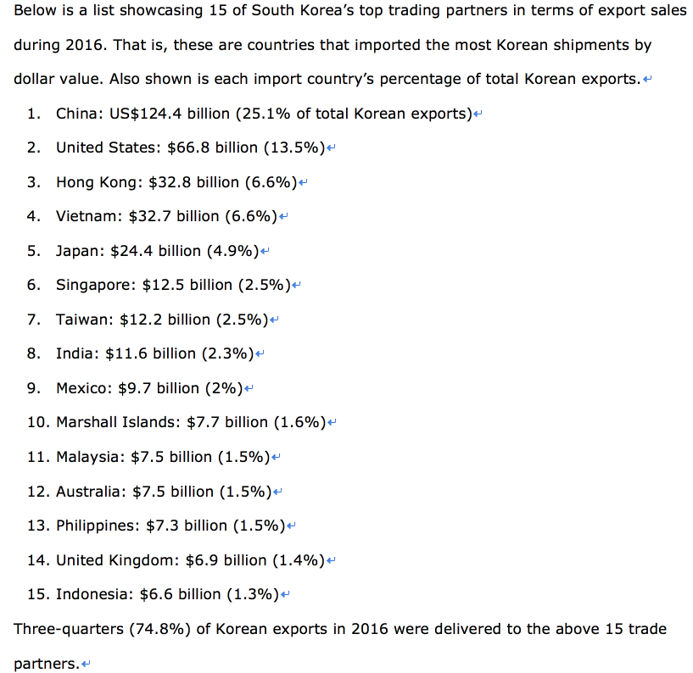
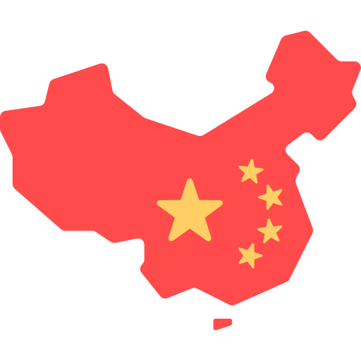





ENVIONMENT
Geography
Connected with America through pacific ocean
Surrounded by yellow sea, the east china sea, and the sea of japan.

Slide 19







ENVIONMENT
Energy
Agriculture
Hydropower
2/3 of the country are mountains and hills.
Ocean energy
The most important crop is rice.
Solar energy
Wind energy
Other grain products heavily rely on imports.

Slide 20






ENVIONMENT
Nuclear pollution
Air pollution
CHALLENGES
Global warming
Other pollution

Slide 21

ENVIONMENT
Seoul Metropolitan Air Quality Improvement Goals
Pollutant | 2003 | 2007 | 2009 | 2011 | 2014
PM₁₀(µg/m³) | 69 | 60 | 55 | 50 | 40
Nitrogen dioxide(ppb) | 38 | 35 | 32 | 28 | 22
Government policies
1st Seoul metropolitan air quality control master plan (2005-2014)
Clean technology project
Four rivers project

Slide 22


LEGAL
Foreign Investment Promotion Act
Foreign Investment zones
Free Trade zones
Tax Incentives
Cash Grants

Slide 23






LEGAL
2. Industries that are completely closed for foreign investors :
Restrictions to enter into South Korea
1. Restriction on foreign investment remain for 30 industrial sectors, out of which 3 are completely closed.
3. Government also reviews the foreign investments that affect national security

Slide 24

Notes:
此处可以加一些能源图片，比如海浪潮汐什么的。。。

